Slide 1
The High Cadence Planetary Geomagnetic Index Hp
Claudia Stolle^{1,2}, Jürgen Matzka¹, Guram Kervalishvili¹, Jan Rauberg¹, Sean Bruinsma³, Yosuke Yamazaki¹
¹ GFZ Potsdam, Germany
² University of Potsdam, Germany
³ CNES, Toulouse, France
http://swami-h2020.eu/

Slide 2
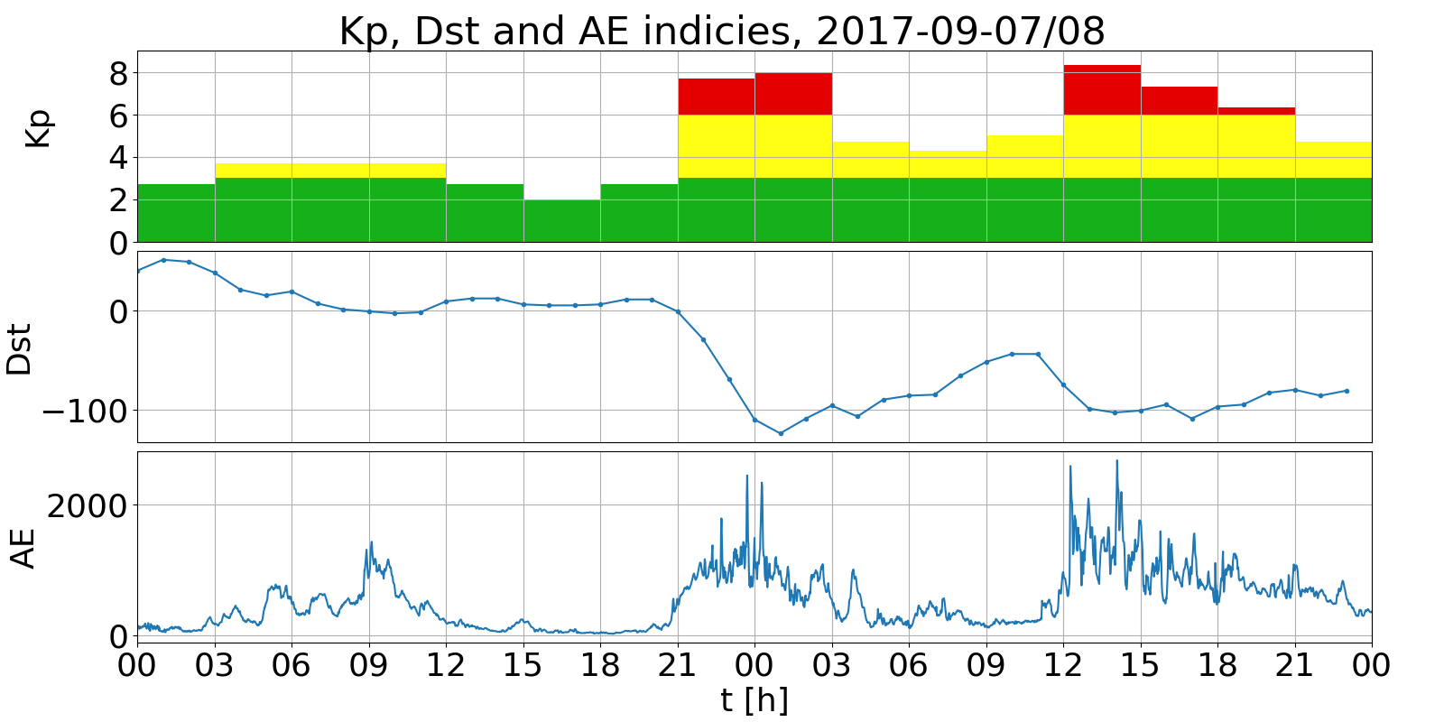
Geomagnetic indices Kp, Dst, AE : 2017 – 09 – 07/08
Subauroral- and mid-latitudes
time res.: 3hs
Low-latitudes/ magnetosphere
time res.: 1h
Auroral-latitudes
time res.: 1min

Slide 3
Motivation for higher resolution Kp-like index
Kp/ap is a widely used index to specify geomagnetic activity for space weather monitoring, research, modelling, and data selection
Increased temporal resolution of global geomagnetic activity enables better quantifications of intervals of solar wind energy input into the upper atmosphere
SWAMI User survey on geomagnetic indices (44 participants from 15 countries):
most used indices: 1 - Kp, 2 - Dst, 3 - AE
preferred time resolution for Kp-like index: 60min
Model community desires a 1-hour index with Kp-like statistical properties (e.g. distribution of index values)

Slide 4
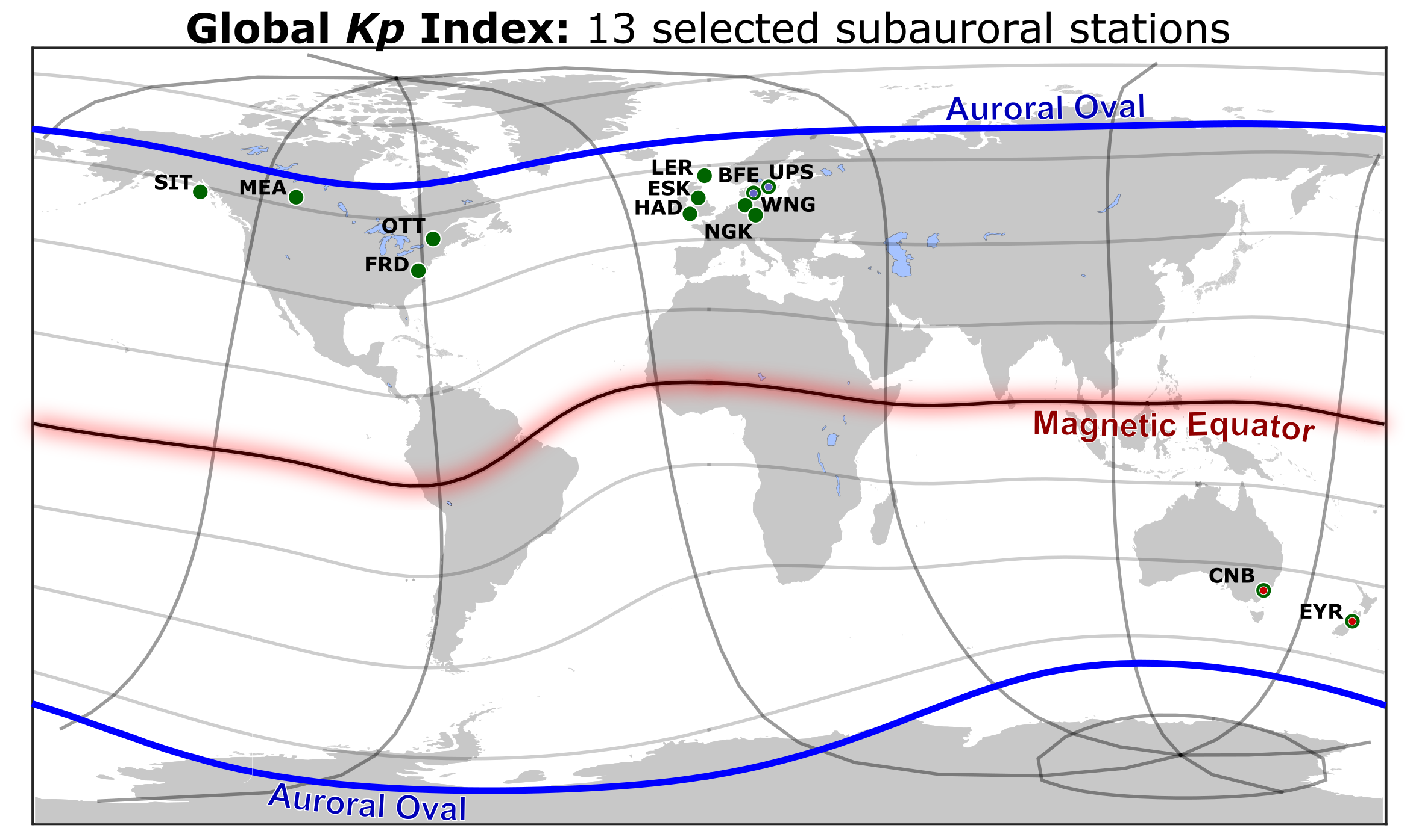
Geomagnetic disturbances index, Kp
“Kp indicates the intensity of geomagnetic activity as expression of solar corpuscular radiation, for every three-hour interval of the Greenwich day.” (Bartels, 1957)
Data from 13 subauroral stations
Kp: “planetarische Kennziffer” (= planetary index)
3-hour interval index, 0 – 9, since 1932
Global index endorsed by IAGA, derived and distributed by GFZ Potsdam
http://www.gfz-potsdam.de/en/kp-index/
Notes:
heute: measure of solar wind energy input to system earth

Slide 5
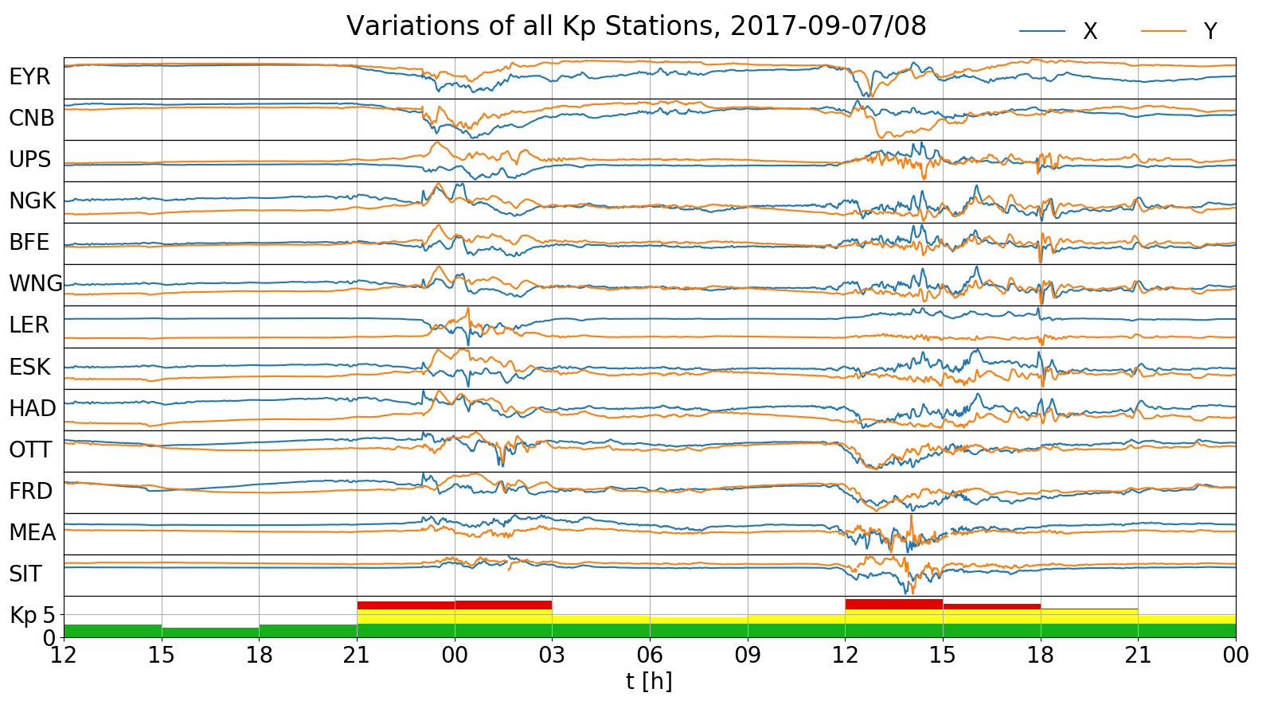
Geomagnetic variations at 13 Kp stations and Kp index
2017 – 09 – 07/08

Slide 6
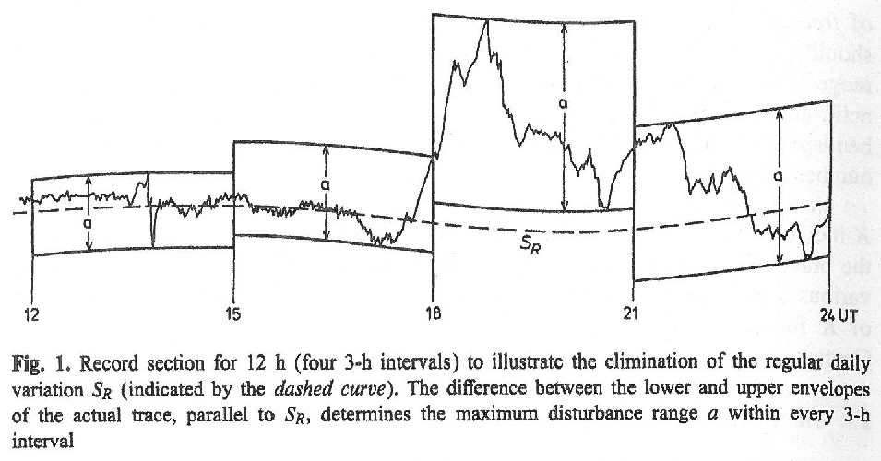
Local geomagnetic activity index, K
Local K index
X and Y components
Quiet-day (Sq) variation pattern removal procedure
Station-related K index: maximum variation within 3-hour time intervals for the most disturbed field component, X or Y
Standardized Ks index
Normalization of K values to avoid (seasonally dependent) LT biases
Ks index: conversion tables to eliminate these effects
Global Kp index
mean of Ks from 13 observatories
Fig: Siebert (1996)
Notes:
Presentation mode!

Slide 7
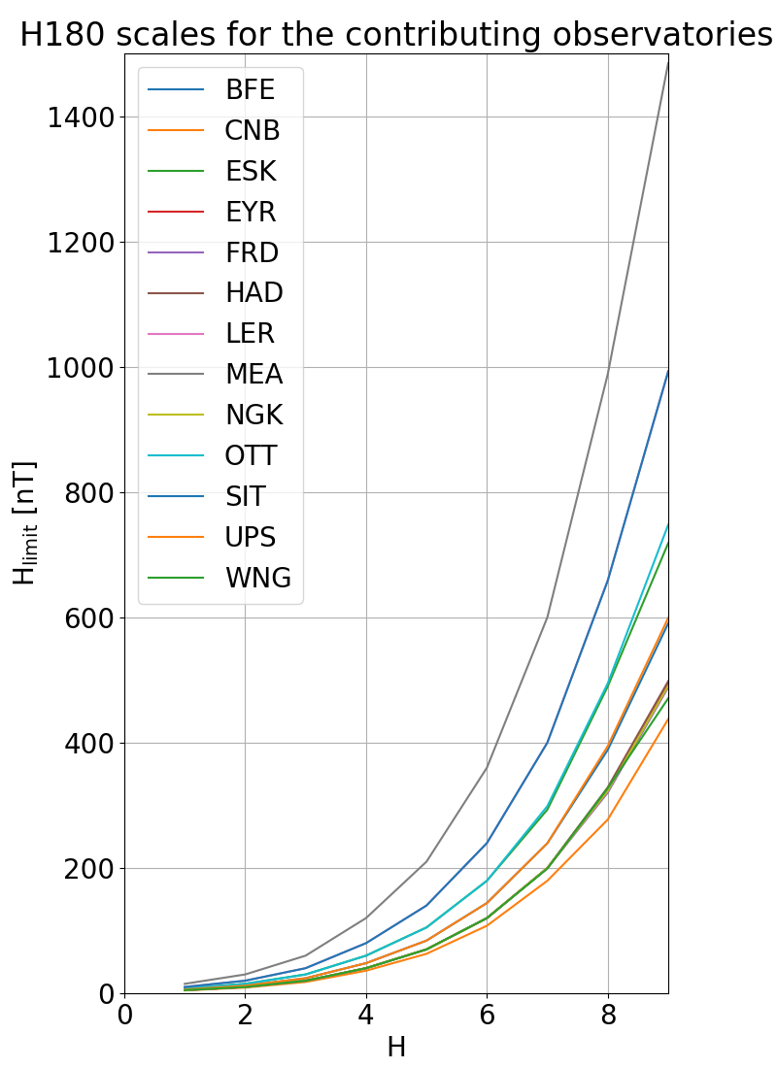
Local geomagnetic activity index, K
K
Local K index
X and Y components
Quiet-day (Sq) variation pattern removal procedure
Station-related K index: maximum variation within 3-hour time intervals for the most disturbed field component, X or Y
Standardized Ks index
Normalization of K values to avoid (seasonally dependent) LT biases
Ks index: conversion tables to eliminate these effects
Global Kp index
mean of Ks from 13 observatories
K_limit
K
Notes:
Presentation mode!

Slide 8
Local geomagnetic activity index, K
Local K index
X and Y components
Quiet-day (Sq) variation pattern removal procedure
Station-related K index: maximum variation within 3-hour time intervals for the most disturbed field component, X or Y
Standardized Ks index
Normalization of K values to avoid (seasonally dependent) LT biases
Ks index: conversion tables to eliminate these effects
Global Kp index
mean of Ks from 13 observatories
Conversion table for Niemegk K -> Ks:
UT-intervals vs. K magnitude -> value/3
Notes:
Presentation mode!

Slide 9
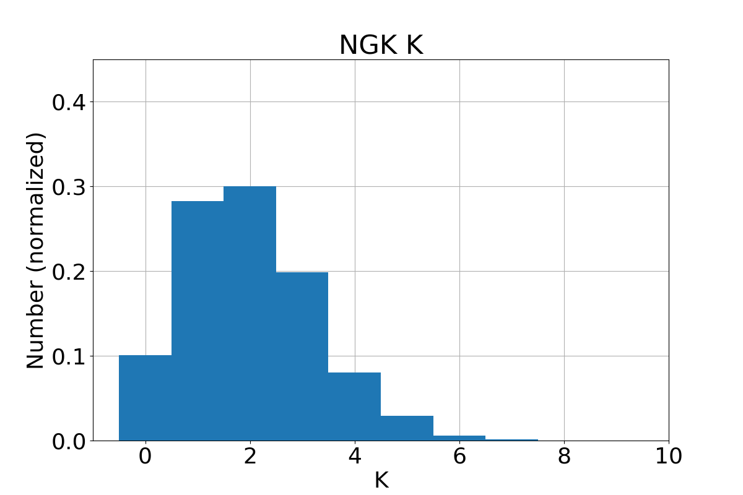
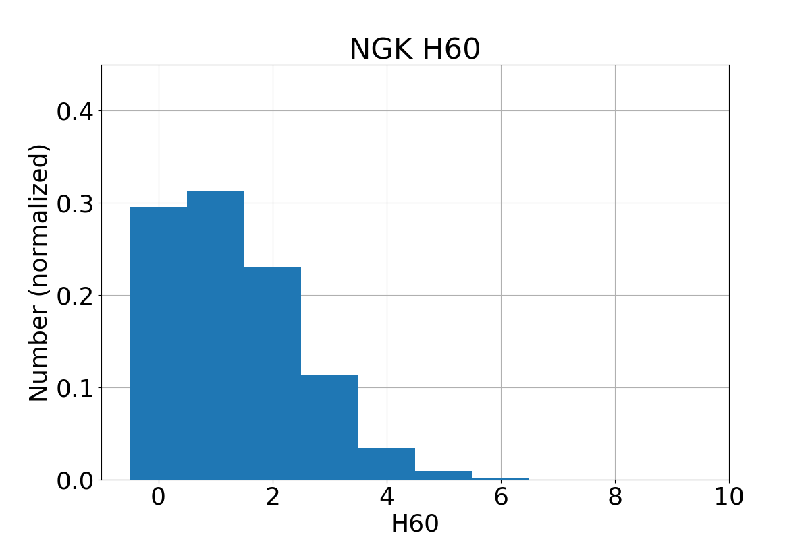
Local geomagnetic activity indices H, Hs, and Hp
Based on data from 1995 – 2017 (digital 1min values available for all 13 stations since 1995)
Developed indices Hp90, Hp60, Hp30 (90, 60, 30min cadence)
Quiet-day (Sq) variation pattern removal procedure as for K
H index: maximum variation within 90, 60, 30-minutes time intervals for the most disturbed field component
But: assigning H index values to the observed geomagnetic variation using the same limits as for K leads to significant changes in the distribution towards lower values example: Niemegk (NGK), H60

Slide 10
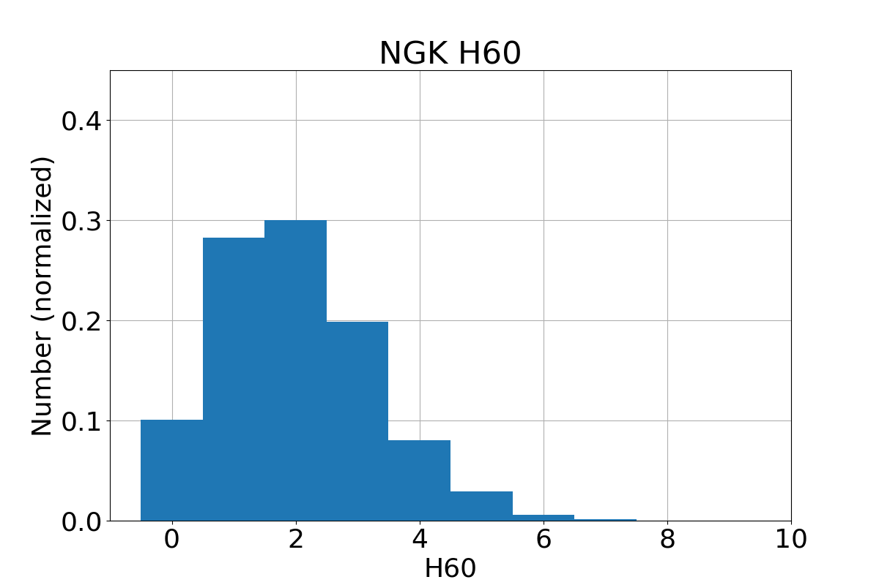
Local geomagnetic activity indices H, Hs, and Hp
Based on data from 1995 – 2017 (digital 1min values available for all 13 stations since 1995)
Developed indices Hp90, Hp60, Hp30 (90, 60, 30min cadence)
Quiet-day (Sq) variation pattern removal procedure as for K
H index: maximum variation within 90, 60, 30-minutes time intervals for the most disturbed field component
Adopt K limits such that H value distribution corresponds to the K value distribution
Now: Same distribution of Ks and Hs example: Niemegk (NGK), H60

Slide 11
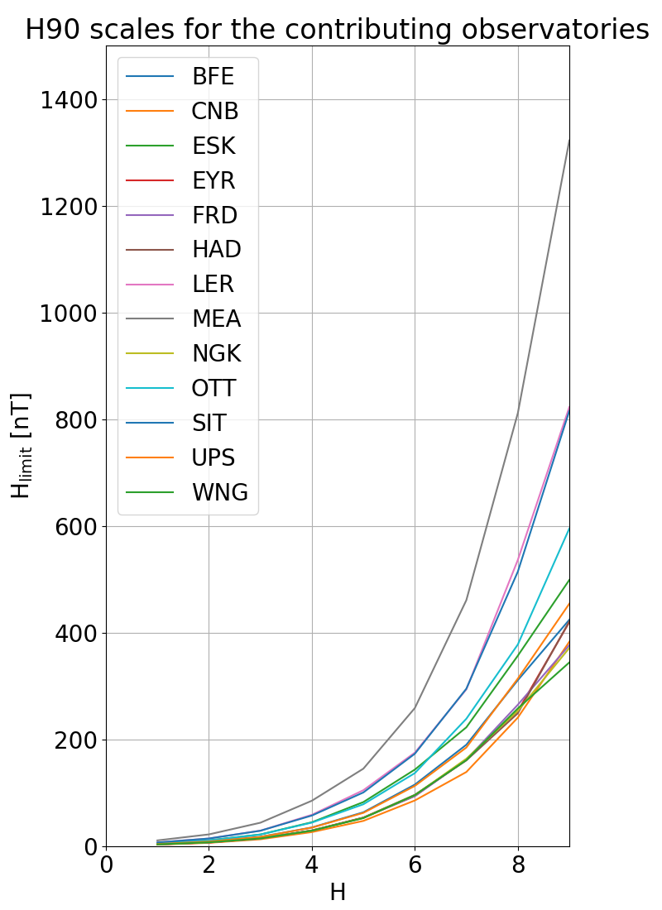
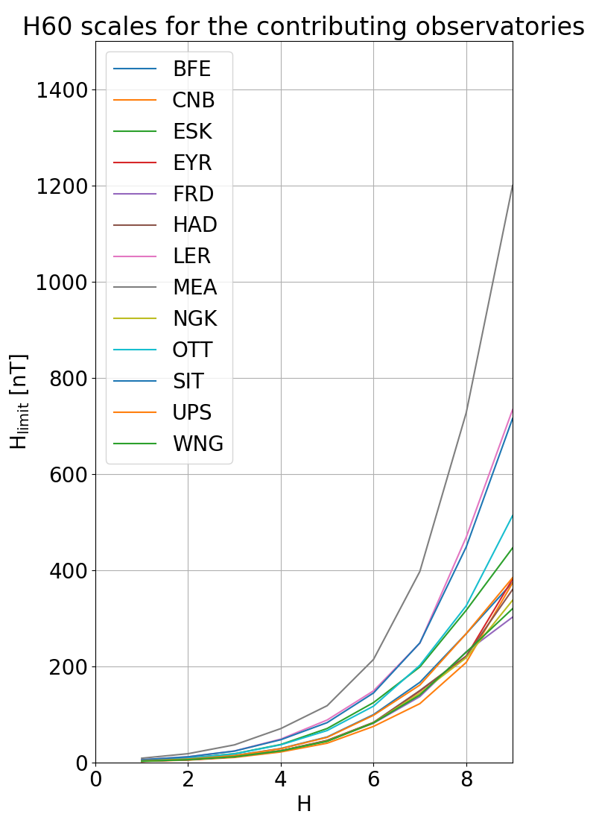
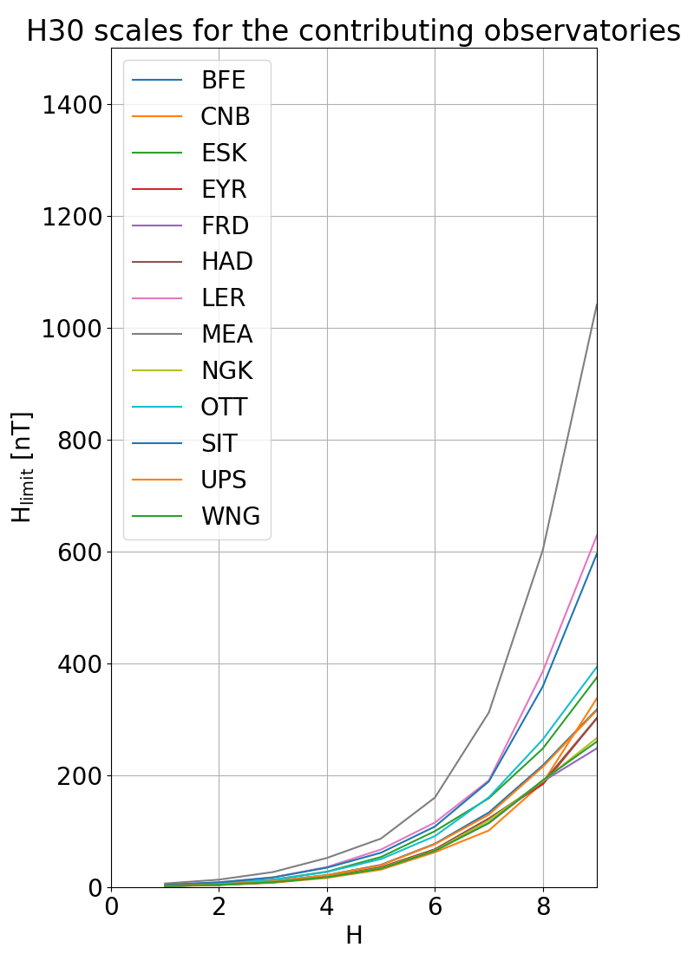
Limits to convert from nT-range values to Hs indices
Notes:
New figures ok: 23 June

Slide 12
Local geomagnetic activity indices H, Hs, and Hp
Based on data from 1995 – 2017 (digital 1min values available for all 13 stations since 1995)
Developed indices Hp90, Hp60, Hp30 (90, 60, 30min cadence)
Quiet-day (Sq) variation pattern removal procedure as for K
H index: maximum variation within 90, 60, 30-minutes time intervals for the most disturbed field component
Adopt K limits such that H value distribution corresponds to the K value distribution
H normalized to Hs using the normalization table for K to Ks
Averaging to Hp
Map mean value of Hs to Hp index value in such a way that the distribution of Hp is similar to Kp

Slide 13
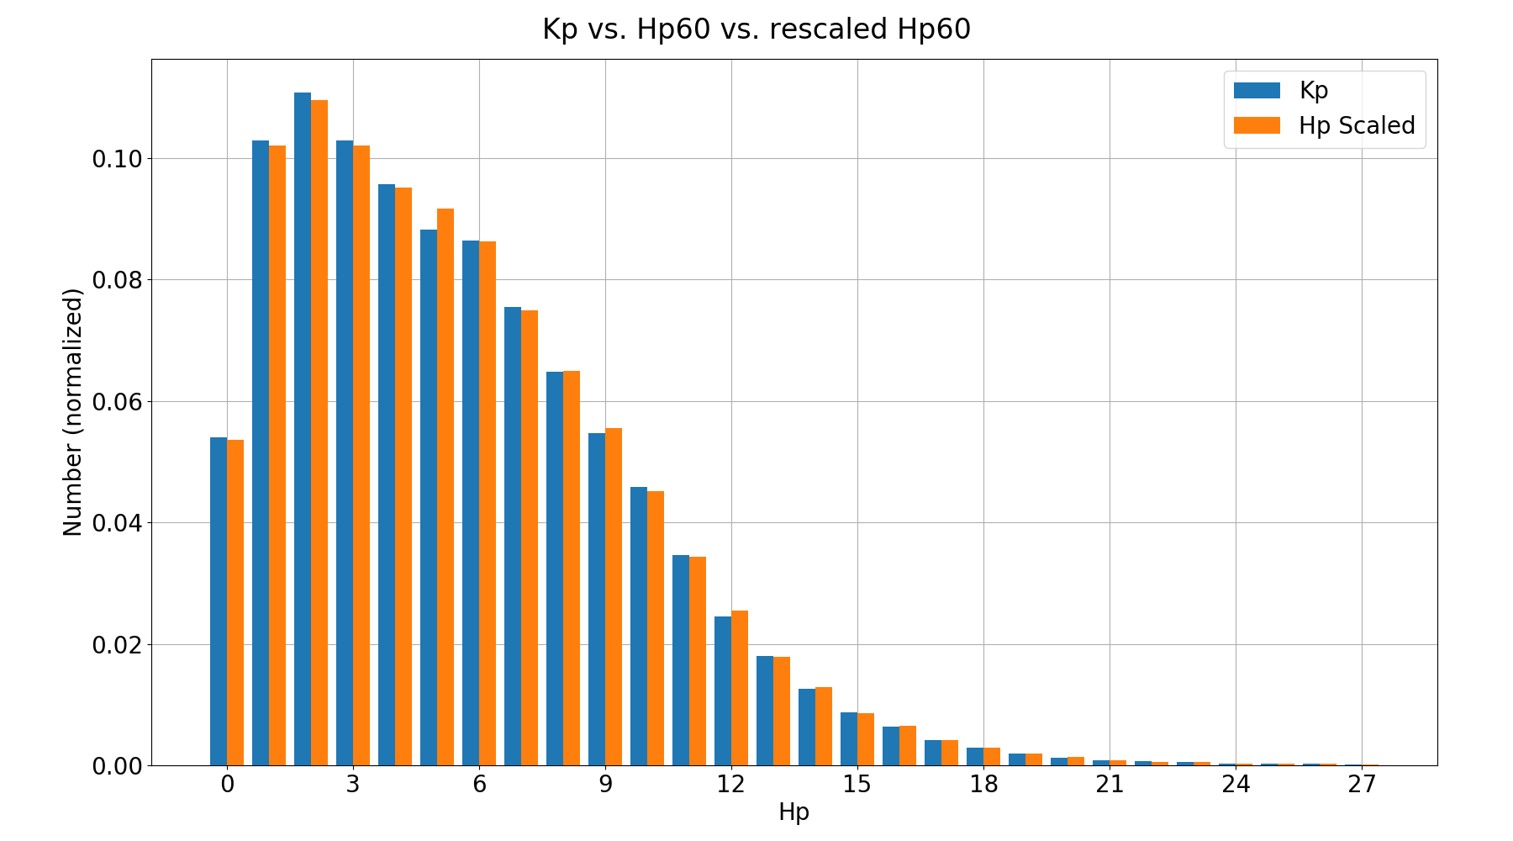
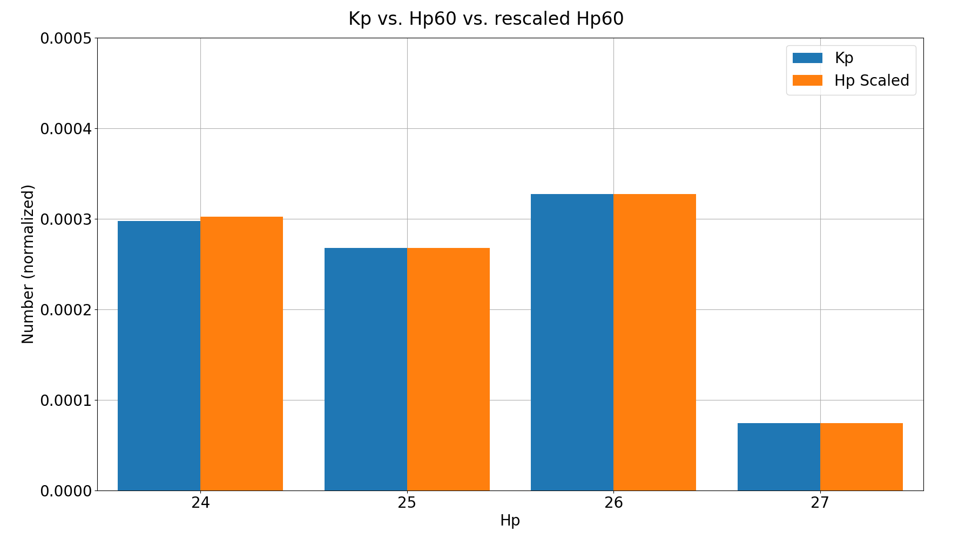
Density distribution of Kp and Hp indices
ca. 22,000 Hp60 values
66 Hp60 values
18 Hp60 values

Slide 14
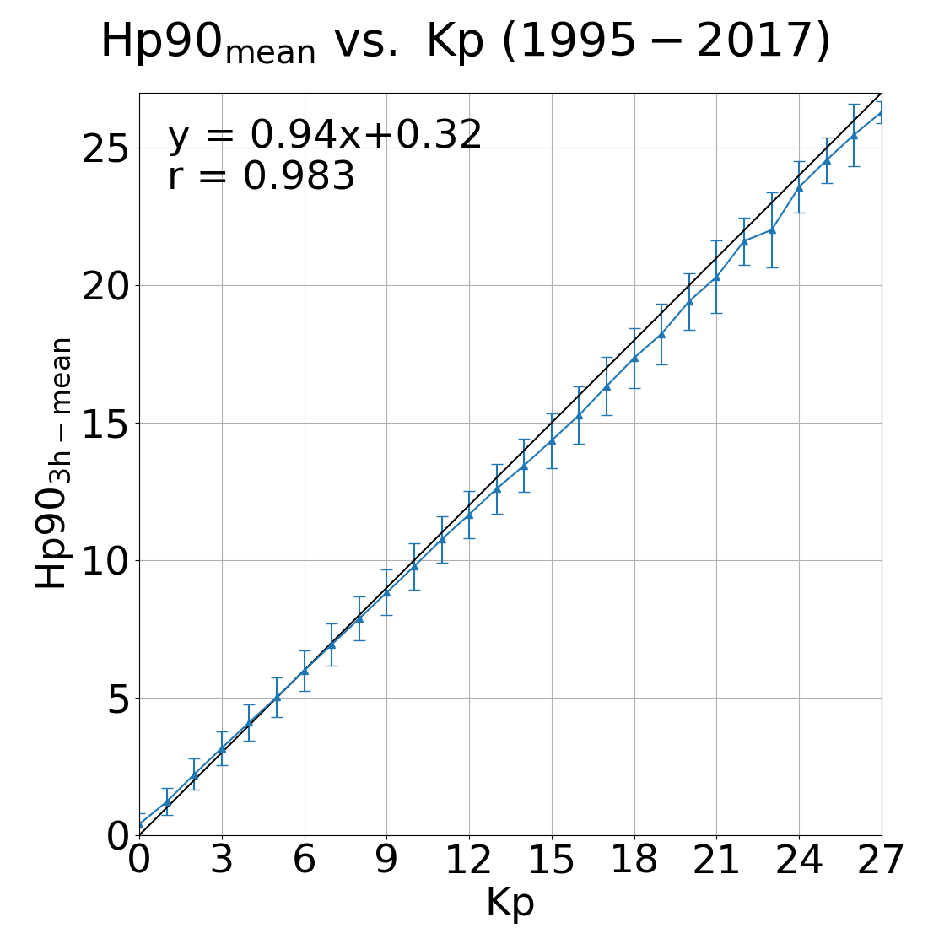
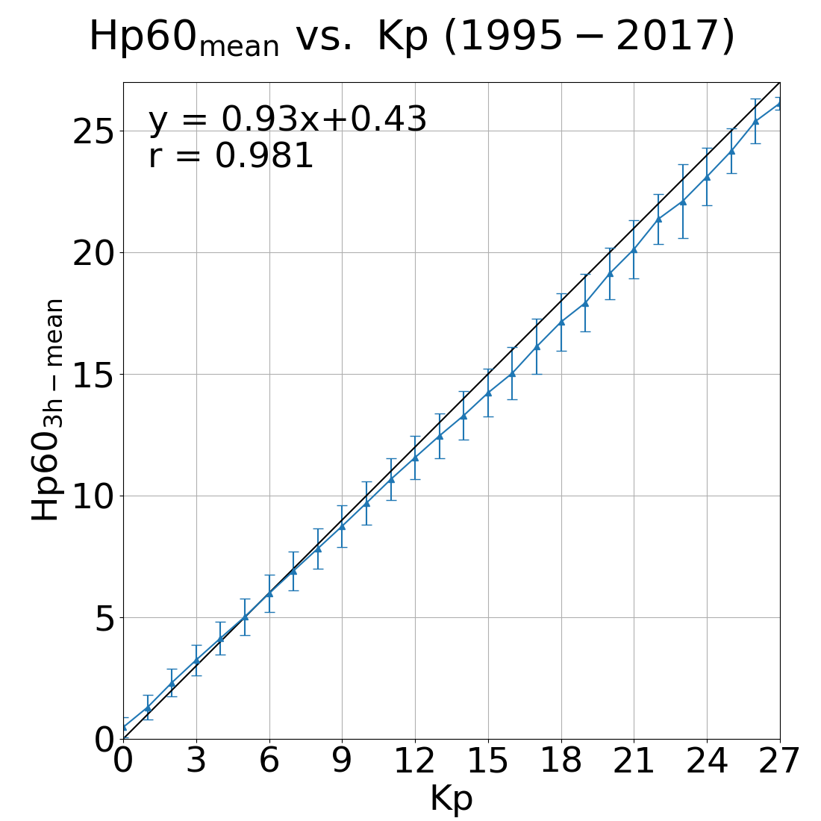
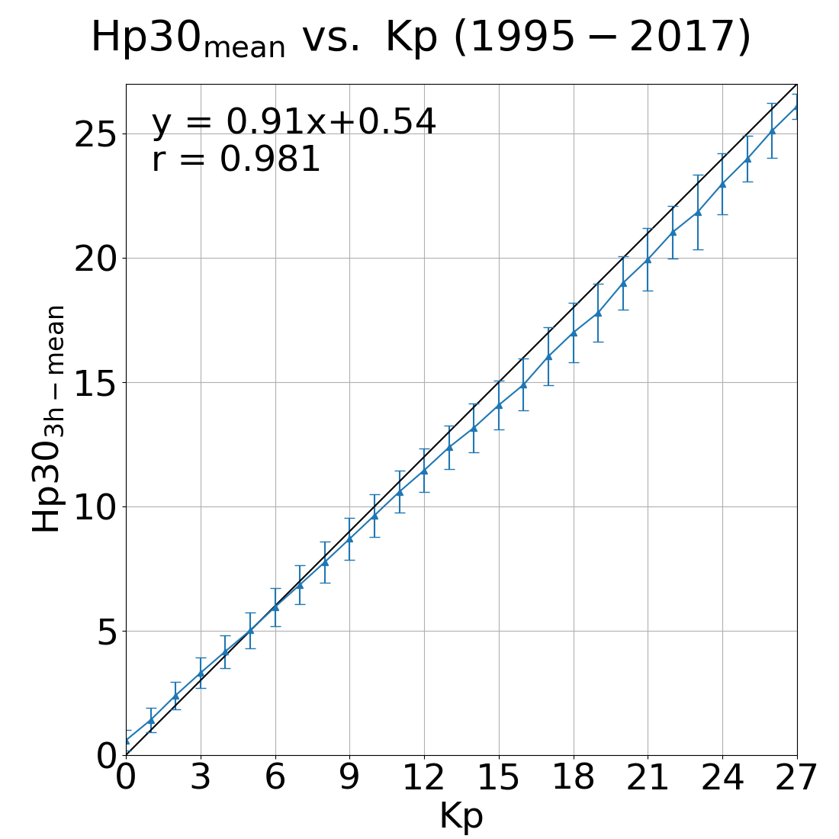
Kp vs. Hp indices : 1995 – 2017
Notes:
Linear correlation coefficient + linear regression line equation

Slide 15
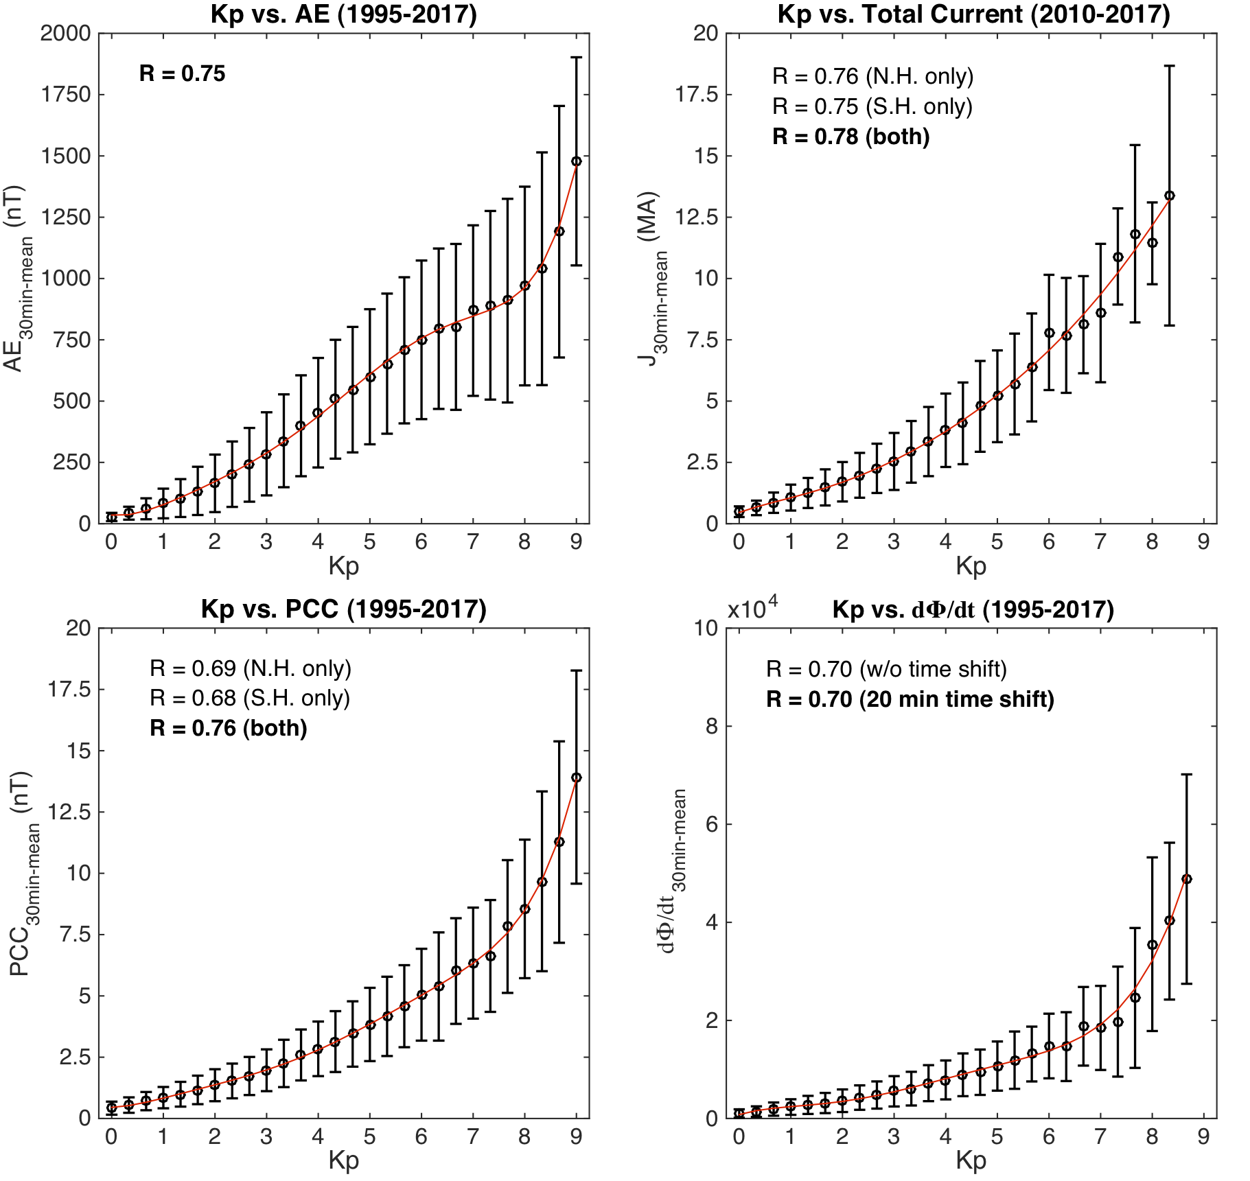
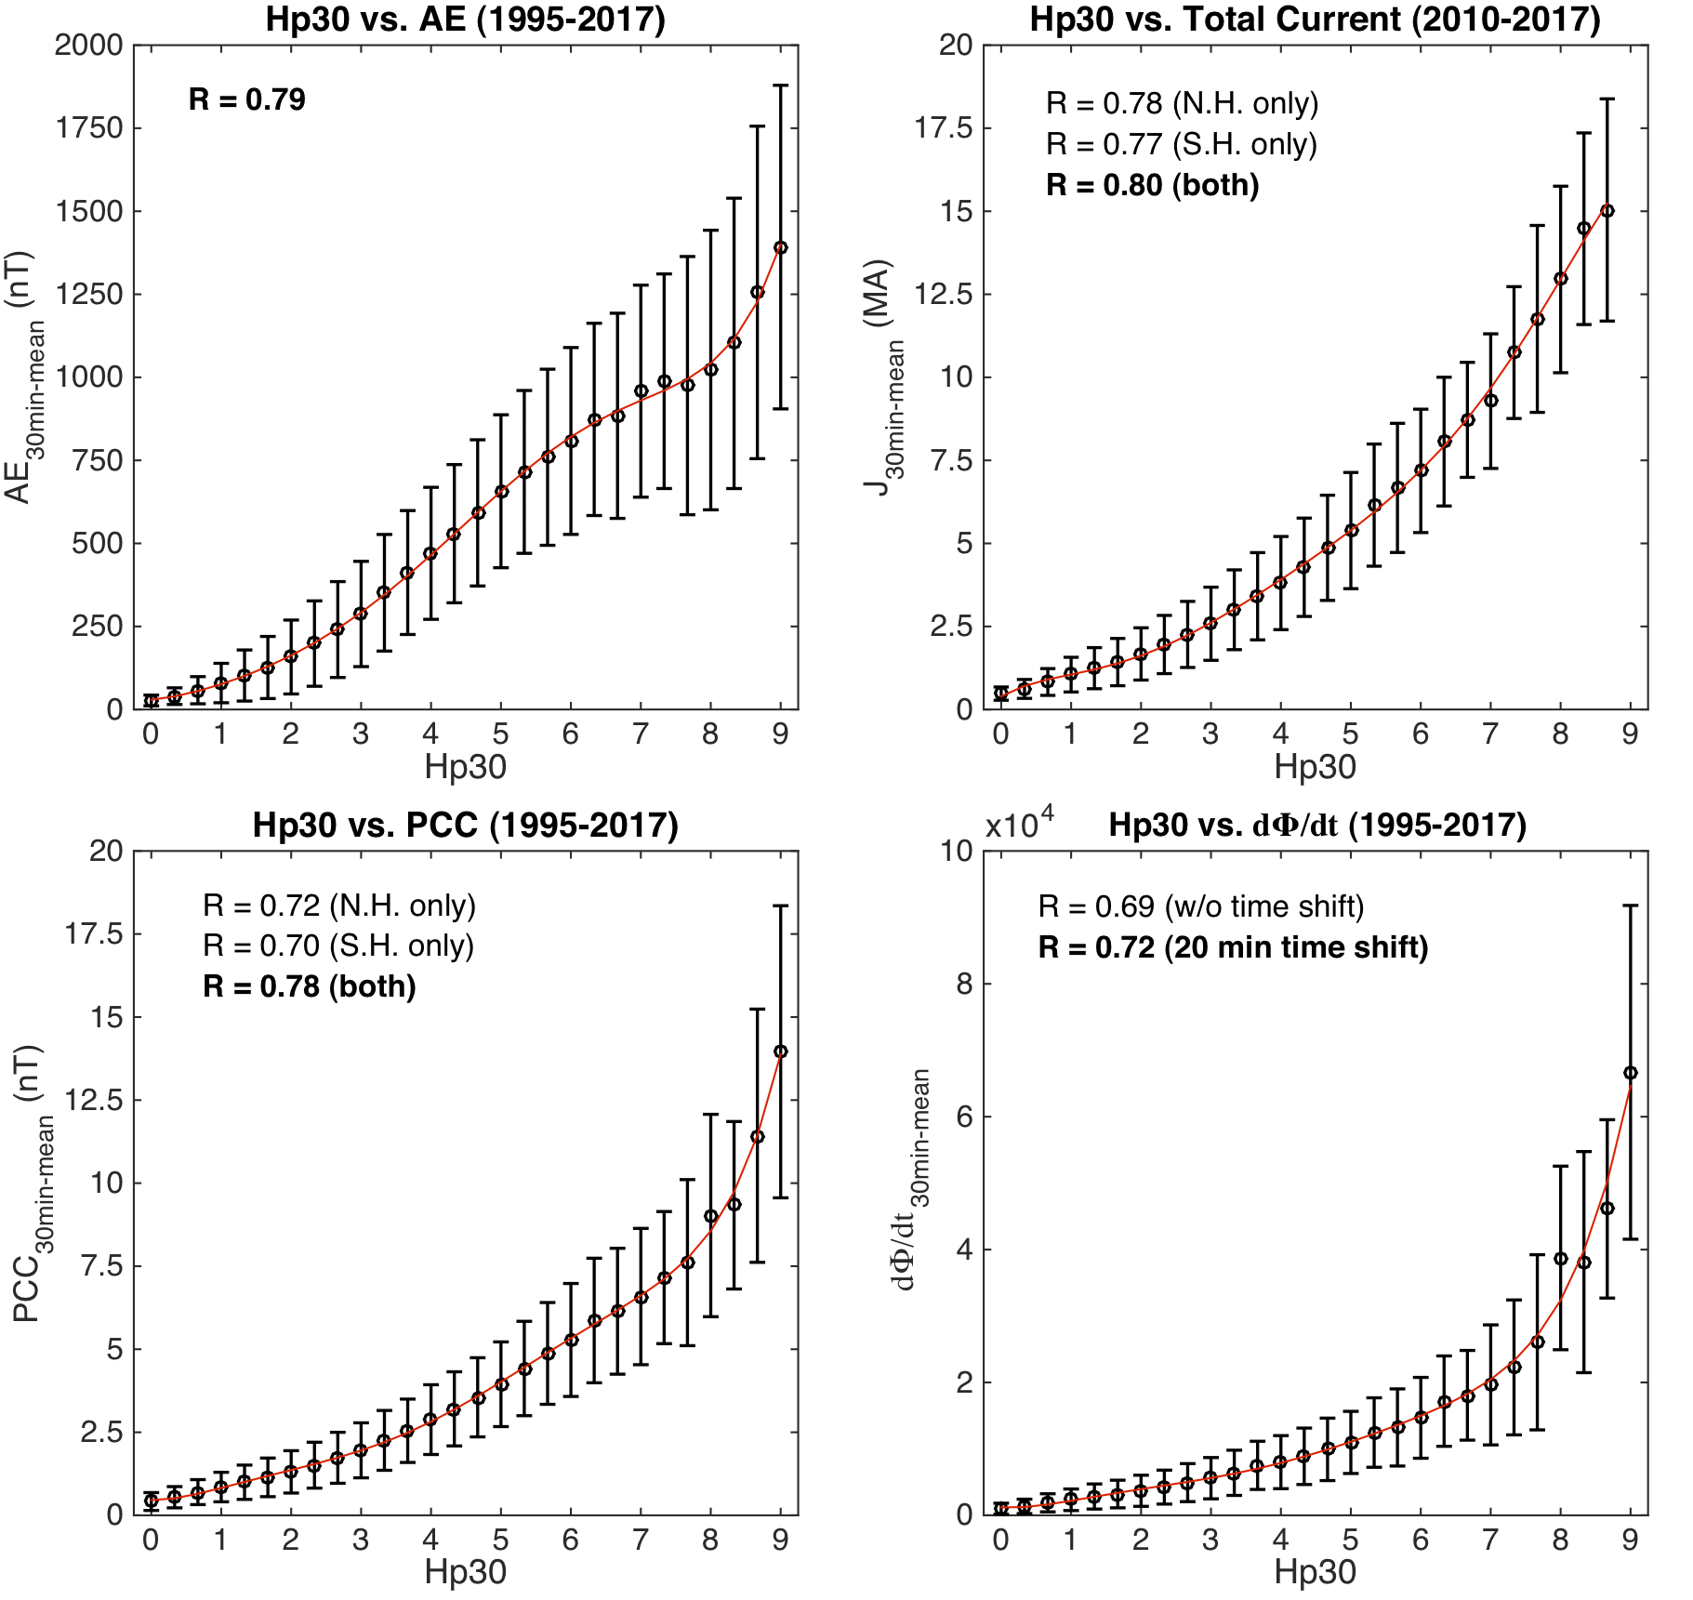
Kp, Hp30 indices vs. AE, AMPERE Total current, PCI,
Newell coupling function : 1995 – 2017
Notes:
Newell coupling function, describe what has been done

Slide 16
Geomagnetic variations at 13 Kp stations and Kp index 2017 – 09 – 07/08

Slide 17
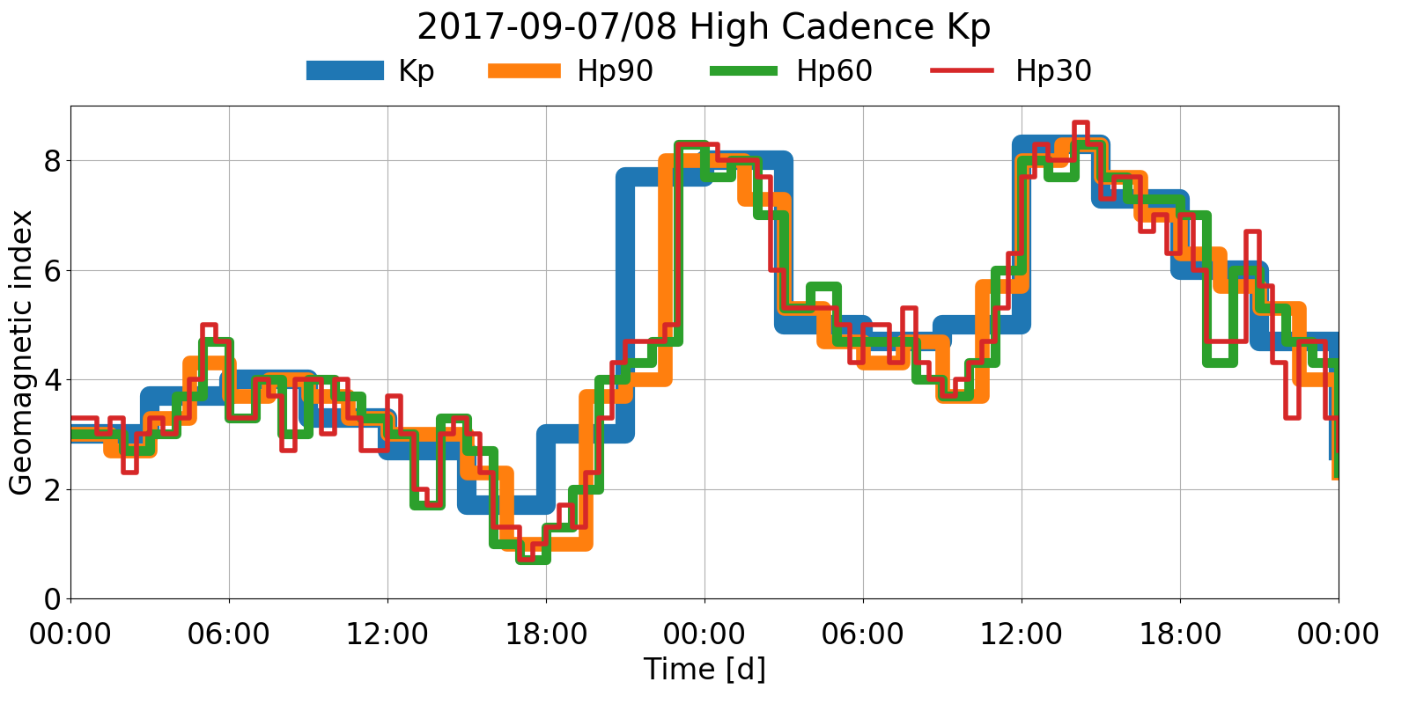
Kp, Hp indices: 2017 – 09 – 07/08

Slide 18
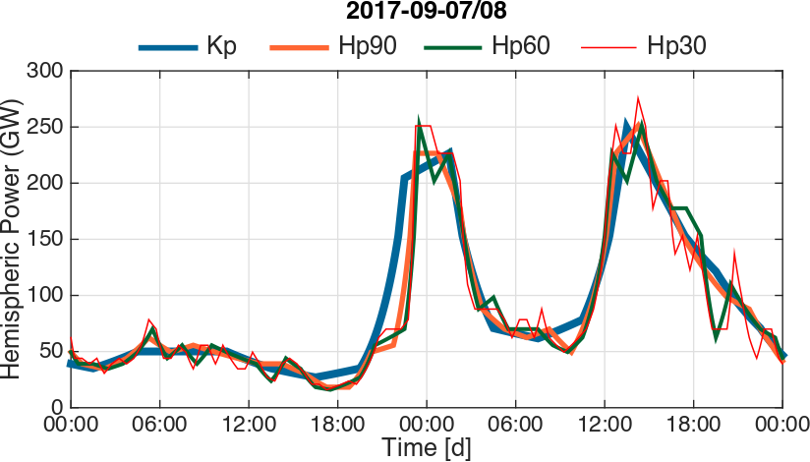
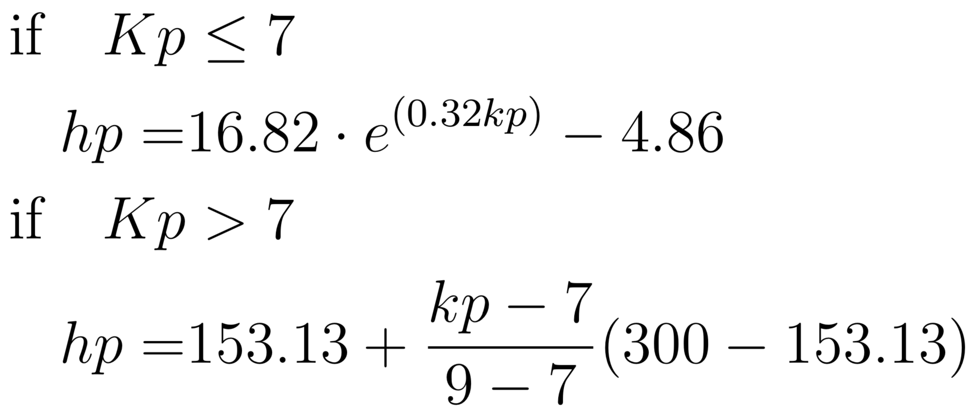
Hemispheric power: 2017 – 09 – 07/08
After Zhang and Paxton (2008)
Notes:
Interposlated to 30s as is used in TIEGCM for a 2.5˚x2.5˚ run under storm conditions.
Interated power over the storm.

Slide 19
Hemispheric power: 2017 – 09 – 07/08
Kp and Hp are interpolated to 30sec, as done for TIEGCM runs at 2.5˚x2.5˚ resolution under storm conditions.
Notes:
Interposlated to 30s as is used in TIEGCM for a 2.5˚x2.5˚ run under storm conditions.
Interated power over the storm.

Slide 20
Hemispheric power: 2017 – 09 – 07/08
Integrated total energy input:
Kp: 1.59e7 GJ
Hp90: 1.54e7 GJ (-3.1%)
Hp60: 1.51e7 GJ (-4.6%)
Hp30: 1.52e7 GJ (-4.0%)
Notes:
Interposlated to 30s as is used in TIEGCM for a 2.5˚x2.5˚ run under storm conditions.
Interated power over the storm.

Slide 21
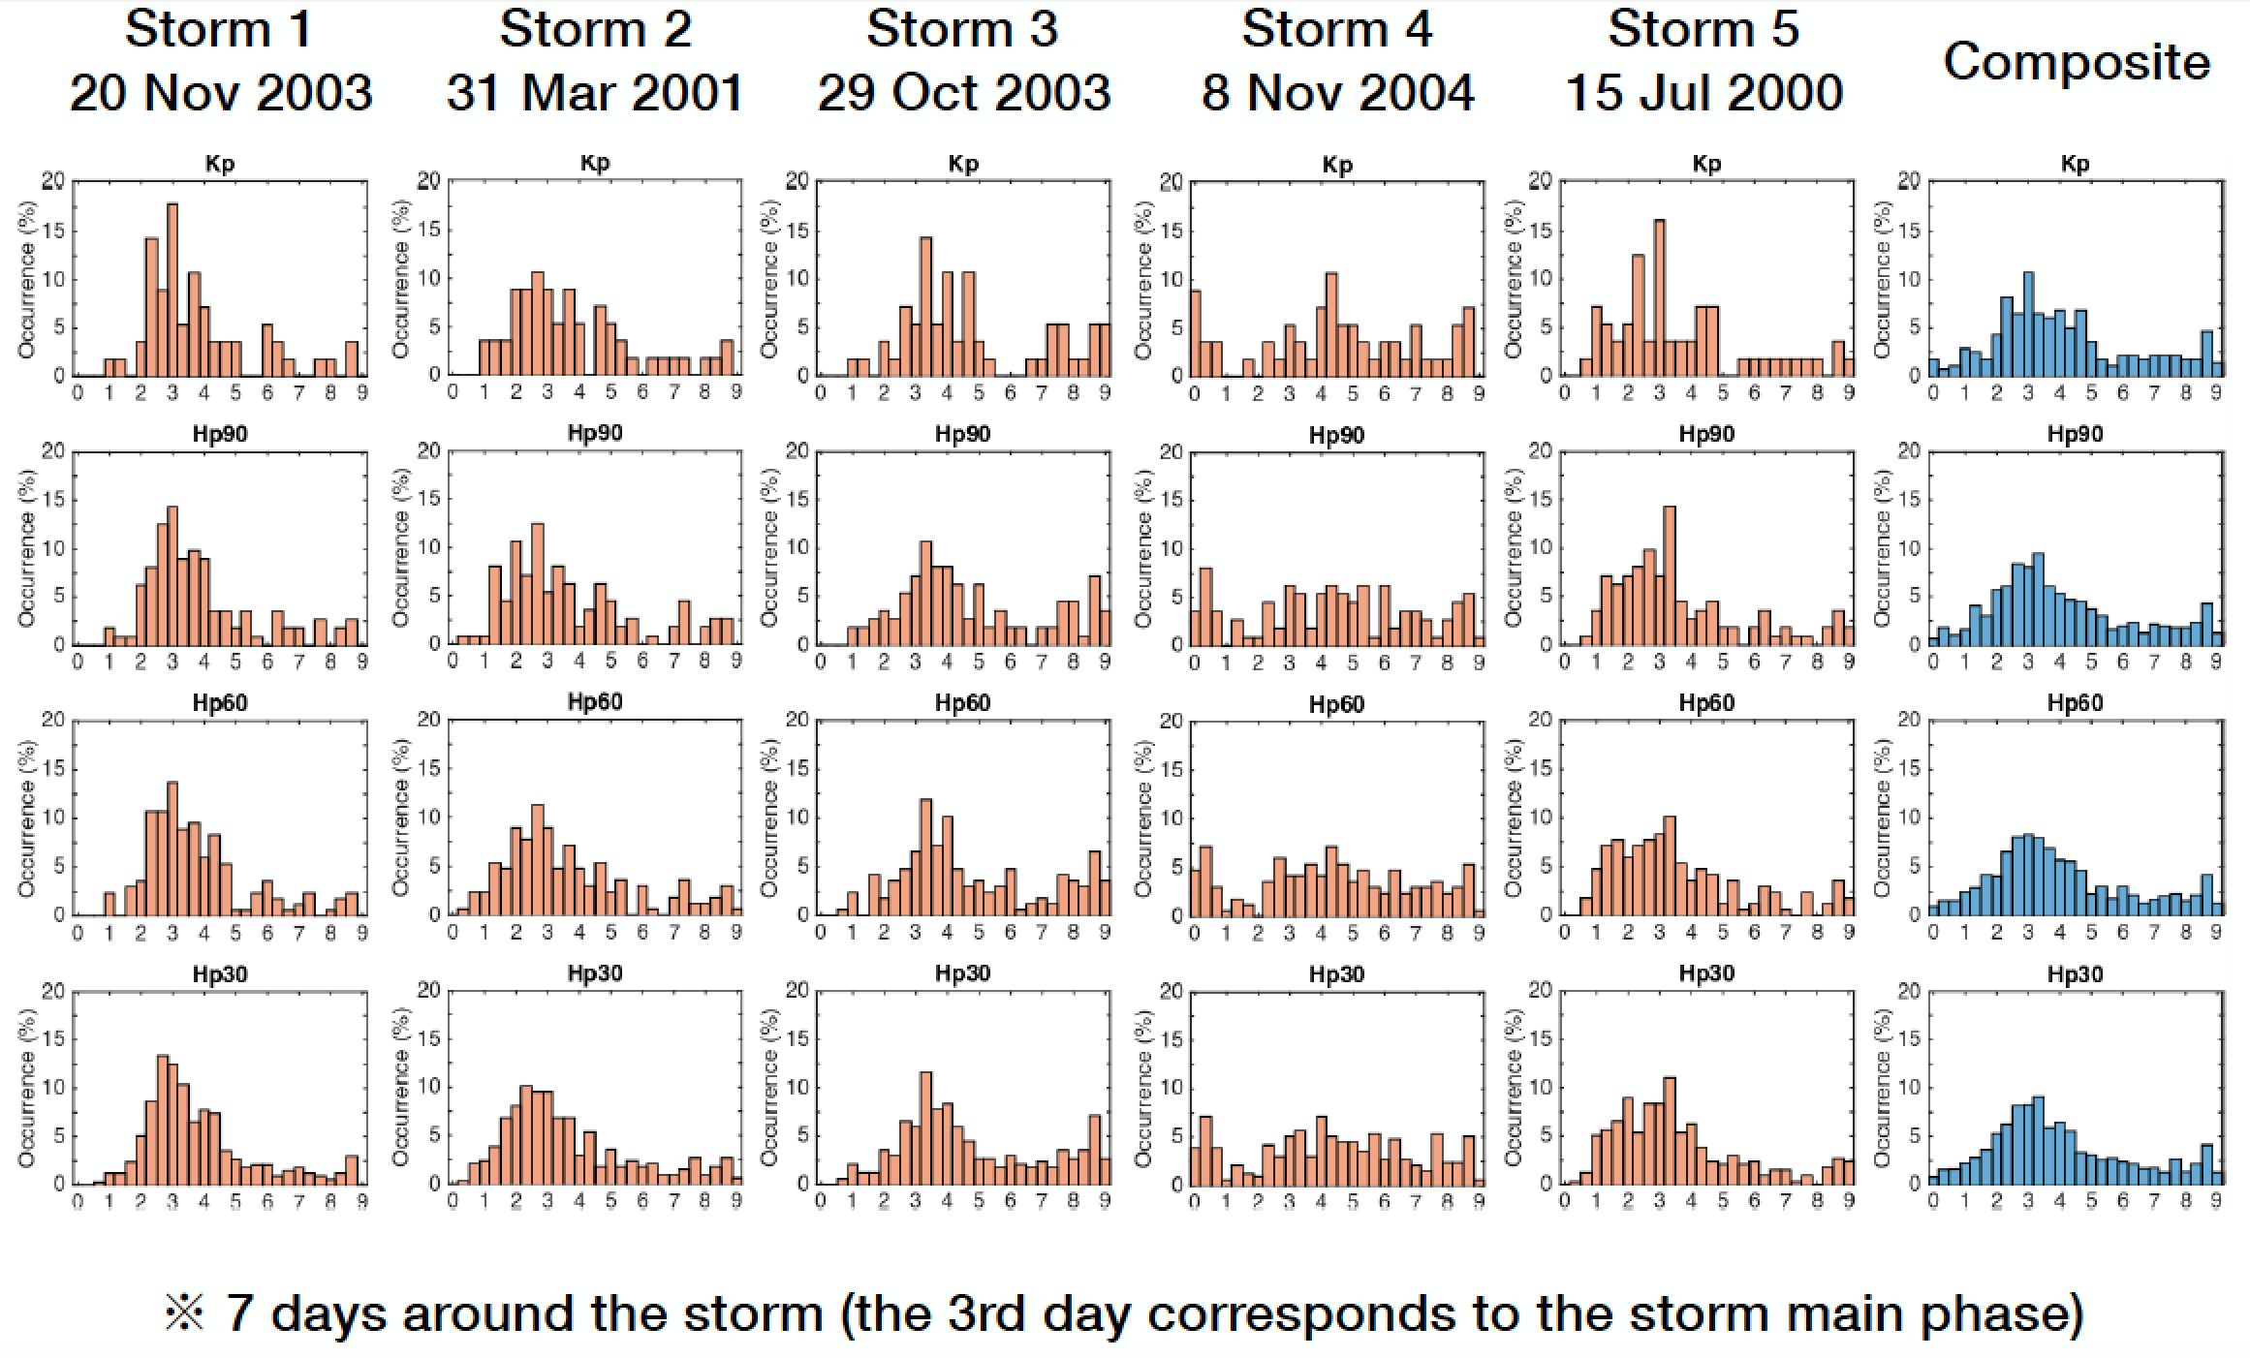
Storm cases with Dst < -300nT

Slide 22
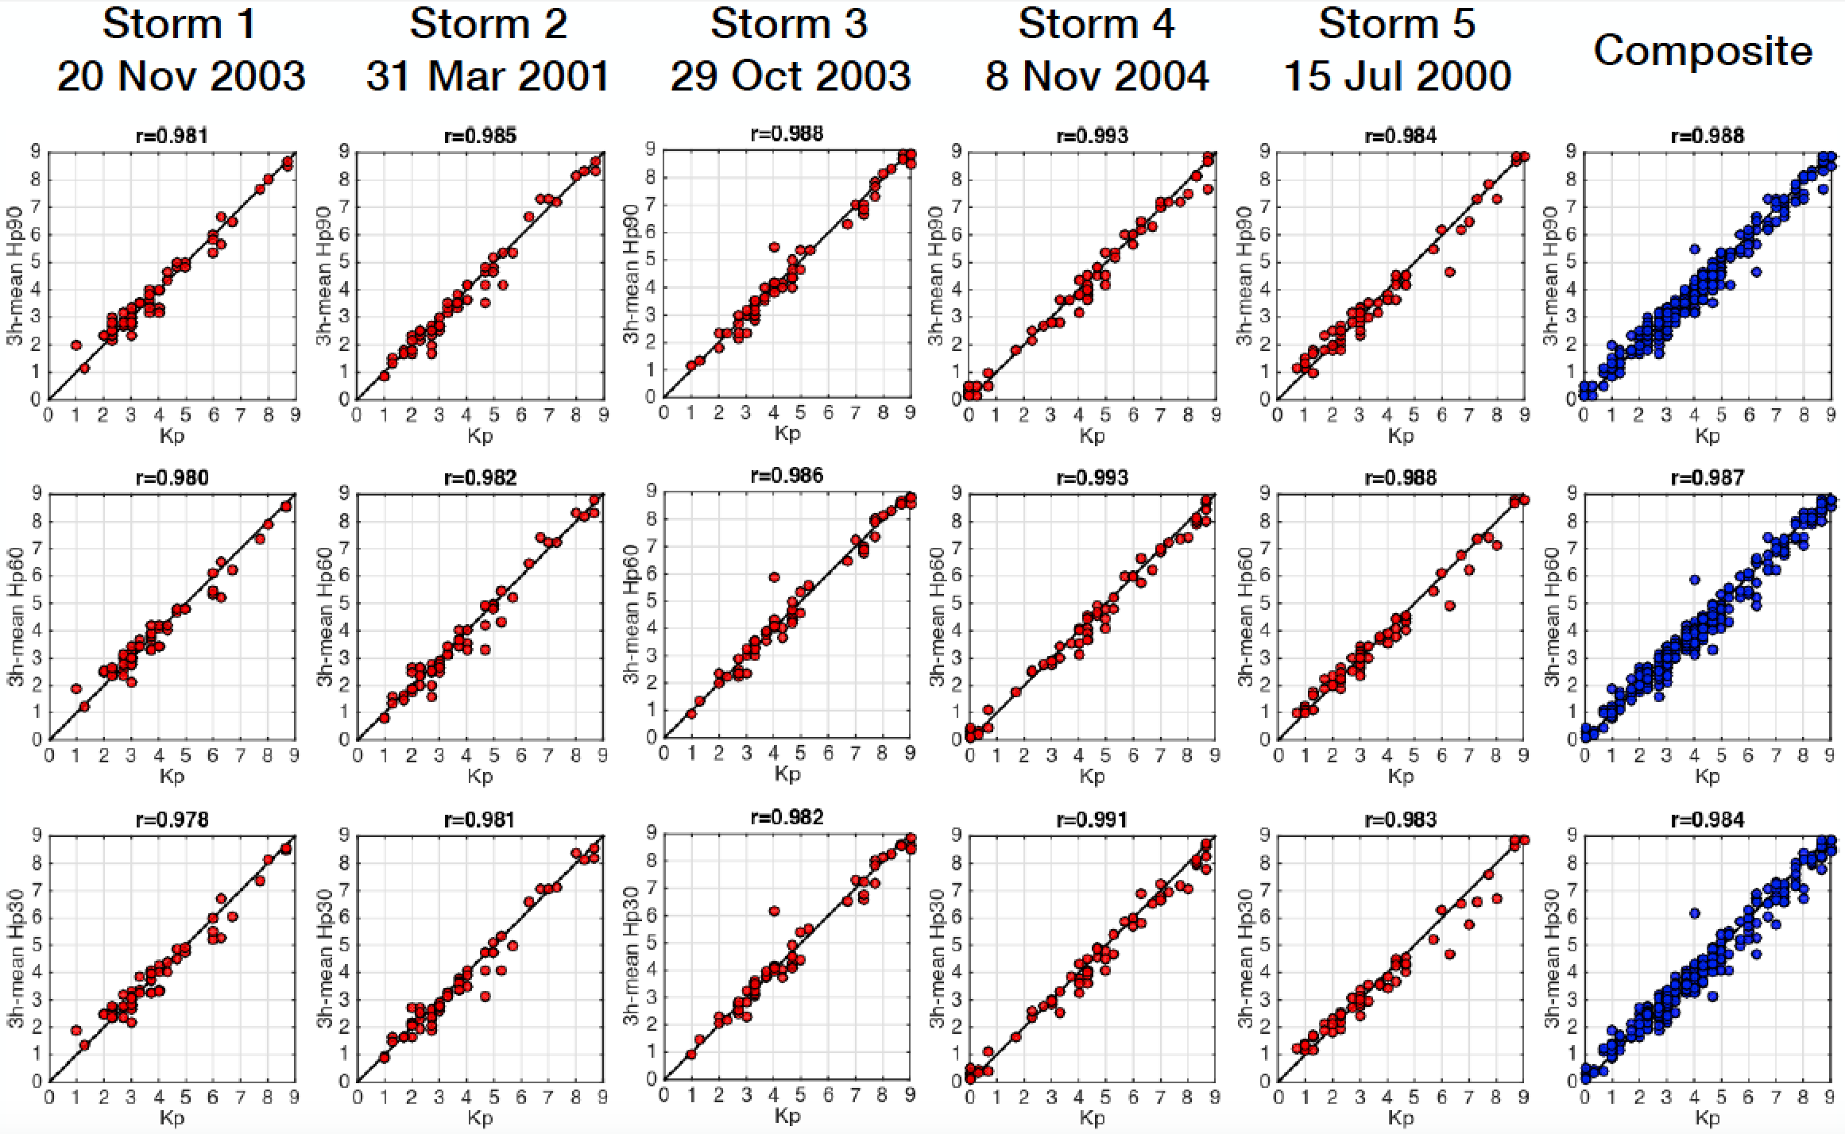
Storm cases with Dst < -300nT

Slide 23
Summary and conclusion
Hp indices based on Kp algorithm with very good representation of geomagnetic activity at increased time resolution:
similar density distribution compared to Kp index
good correlation to other, independent geomagnetic indices and solar wind data
integrated hemispheric power differs within about 4% at September 7/8, 2019

Slide 24
Welcome to use the new index!
Test dataset available from GFZ, see link on:
http://swami-h2020.eu/
Content:
Years 2003,2004,2005,2017
Hp90, Hp60, Hp30, ap90, ap60, ap30
Technical note and this presentation
Feedback welcome!
DOI: 10.5880/GFZ.2.3.2019.002
CC-BY 4.0
Disclaimer to users of the Hp indices test dataset:
Please carefully test and validate all your model output and services for which you use the Hp indices (including the ap90, ap60, ap30) as input parameter. This is especially true when these models and services were originally derived or parameterized with the Kp index.
We acknowledge INTERMAGNET and the contributing observatories for providing high quality geomagnetic data.

