Slide 1



DTM2019 in the framework of the H2020 project SWAMI
This project has received funding from the European Union’s Horizon 2020 research and innovation programme under grant agreement No 776287
Sean Bruinsma
CNES - Space Geodesy Office
Toulouse, France
16th European Space Weather Week, Liège, Belgium
Session 3 (18 November 2019)

Slide 2
S. Bruinsma
Space Geodesy Office
02 / 20
SWAMI project objectives
Space Weather Atmosphere Model and Indices
To develop a model of the whole atmosphere (MOWA) with a science as well as operations-focused approach (MCM). Two existing models of the atmosphere, the UM and the DTM, will be extended and blended to produce this unique new whole atmosphere model, which shall provide estimates of both climatology and space weather variability.
To provide new high-cadence geomagnetic indices, Hp90/60/30, including its nowcast and predictions to be used in the UM and DTM.
To develop steps, including provision of software, model output, or data sharing facilities, to transition the improved model system into operations.

Slide 3
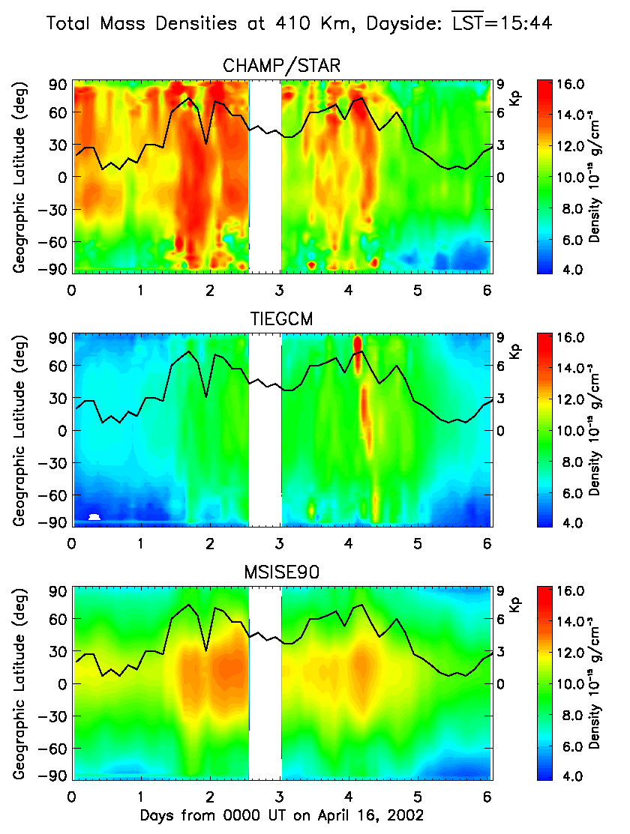
S. Bruinsma
Space Geodesy Office
03 / 20
SWAMI project diagram
1) Develop new index
2) Develop MOWA
Geomagnetic activity:
New algorithm for
High-cadence Hp index
Thermosphere
DTM:
update
&
improve
‘operational’ model: F10.7 & Kp
‘research’ model: F30 & Hp60
Thermosphere observations
Solar activity:
F30 radio flux
+
Surface to LT
4) Develop Kp forecast model
Atmosphere observations
Geomagnetic activity:
High-cadence Hp &
Nowcast and
Forecast
Solar activity:
F30 radio flux &
Nowcast and
Forecast
UM:
Multi-year run
MCM (0-1500 km)
Climatology and weather
re-analysis and predictions:
- Temperature
- Density + composition
- Winds
MOWA
Climatology & Weather
3) Develop MCM

Slide 4
S. Bruinsma
Space Geodesy Office
04 / 20
SWAMI: DTM2019
DTM2019 models are, compared with DTM2013, based on:
More & different data, different preprocessing (no scaling)
Improved data correction and editing
Iterative model development
“OPERATIONAL”
same algorithm as DTM2013
drivers: F10.7 & Kp
complete database
“RESEARCH”
different Hp algorithm
drivers: F30 & Hp
database: 2000-2017

Slide 5
S. Bruinsma
Space Geodesy Office
05 / 20
Solar activity: F107 and F30
Mean solar activity can be quite different, as shown in this example for the last solar max.
The same density datasets are fitted with these solar proxies…

Slide 6
S. Bruinsma
Space Geodesy Office
06 / 20
Total density data
Data used in the construction of DTM2019:
CHAMP 05/2001 - 08/2010 (TU Delft)
GRACE 08/2002 - 12/2016 (CNES scaled to fit TU Delft)
GOCE 11/2009 - 10/2013 (ESA/TU Delft)
Stella 01/2000 - 12/2016
Swarm 11/2013 – 12/2018 (ESA/TU Delft)
TLE(250,400 km) 01/1967 – 12/2007
EDR(200-500 km) 01/1972 – 12/2010
DE-2 (T, He, O, N2) 08/1981 - 02/1983
AE-C (N2) 01/1974 - 04/1977
AE-E (T, He, O) 12/1975 - 05/1981
Thermosphere = 4D
BUT sparse data:
> 2017
< 2002
> 600 km altitude
< 300 km altitude
(and LST, high flux,..)

Slide 7
S. Bruinsma
Space Geodesy Office
07 / 20
Scale of the data
In DTM2013, data were scaled to the USAF model HASDM.
Example: GOCE
(Easy case, because direct comparison)
Determination of scale factors between satellite datasets is necessary but complicated due to:
Altitude
Epoch
LST
Why these differences?

Slide 8
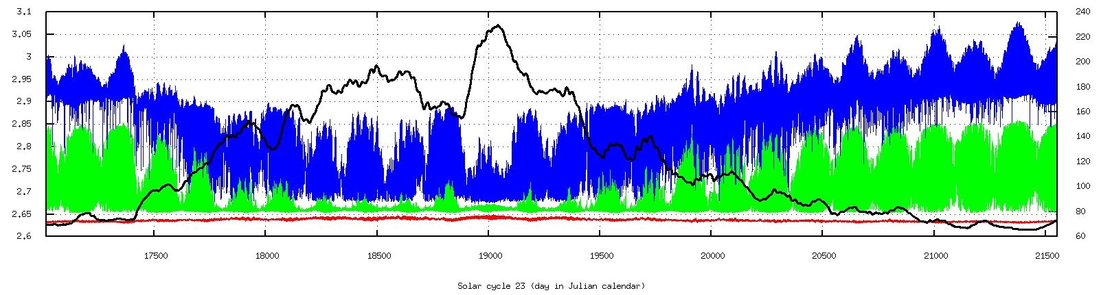
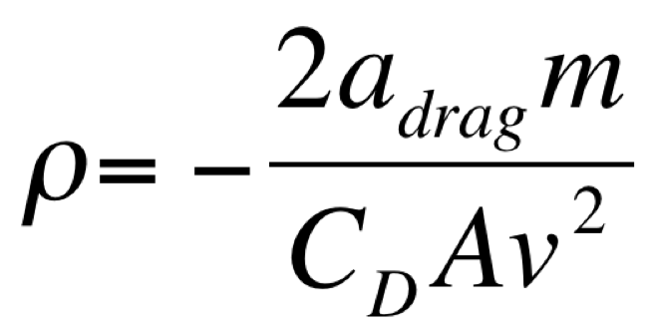
S. Bruinsma
Space Geodesy Office
08 / 20
Scale of the data
Problem: there is no standard, nor consensus within the community, on how aerodynamic drag should be computed.
Differences in the drag calculation are due to:
Level of approximation of the satellite model (sphere, number of panels, undocumented changes, mass,…)
Choice of aerodynamic coefficient model
C_{D} of a sphere (Sentman) over a solar cycle
F10.7
C_{D} 815 km
C_{D} 535 km
C_{D} 235 km

Slide 9
S. Bruinsma
Space Geodesy Office
09 / 20
DTM model: Hp60 algorithm
Hp60 presently implemented as follows:
DTM2013: Kp delayed by 3hr DTM2019: <3 Hp60> delayed 0-4hr (function latitude)
<Kp last 24hr> <Hp60 last 24hr> / Hp> 5: <Hp60 last 12hr>
Using Hp60 and delayed Hp60, or mean of 2 or 3 Hp60 and delayed:
Correlation CHAMP – DTM(Kp=0) & Hp60 = 0.421
& Hp60 – 2hr = 0.468
& Hp60 – 3hr = 0.473
& Hp60 – 4hr = 0.474
& Hp60 <-1,-2> = 0.473
& Hp60 <-2,-3> = 0.482
& Hp60 <-3,-4> = 0.485
& Hp60 <-4,-5> = 0.482
& Hp60 <-1,-2,-3> = 0.488
& Hp60 <-2,-3,-4> = 0.495
& Hp60 <-3,-4,-5> = 0.494
& Hp60 <-4,-5,-6> = 0.488
Higher R with <Hp60 2hr>
Highest R with <Hp60 3hr>

Slide 10
S. Bruinsma
Space Geodesy Office
10 / 20
DTM model: Hp60 algorithm
Hp60 presently implemented as follows:
DTM2013: Kp delayed by 3hr DTM2019: <3 Hp60> delayed 0-4hr (function latitude)
<Kp last 24hr> <Hp60 last 24hr> / Hp> 5: <Hp60 last 12hr>
Latitude bin |30°| |30°;60°| |60°;90°|
Correlation CHAMP – DTM(Kp=0) & Hp60 <-1,-2> 0.479 0.485 0.462
& Hp60 <-2,-3> 0.517 0.489 0.444
& Hp60 <-3,-4> 0.533 0.488 0.437
& Hp60 <-4,-5> 0.524 0.487 0.439
& Hp60 <-5,-6> 0.503 0.480 0.438
& <Hp60 24hr> 0.442 0.403 0.356
& <Hp60 24-48hr> -0.067 -0.078 -0.093
highest
lowest
(NB: test was done with mean of 2 Hp; implementation with mean of 3 Hp)

Slide 11
S. Bruinsma
Space Geodesy Office
11 / 20
Results DTM2019
Mean O/C, StD O/C as a percentage and correlation of the density ratios of the CIRA thermosphere models and the two preliminary DTM versions. (complete datasets)
 | NRLMSISE-00 | JB2008 | DTM2013 | DTM2019_oper | DTM2019_res
CHAMP | 0.69/23.2/0.97 | 0.78/20.2/0.98 | 0.76/19.8/0.98 | 0.96/19.3/0.98 | 1.00/18.8/0.98
GRACE | 0.75/28.8/0/97 | 0.83/26.9/0.98 | 0.76/23.2/0.98 | 0.99/25.8/0.98 | 0.98/22.3/0.98
GOCE | 0.82/14.3/0.97 | 0.81/12.4/0.98 | 0.79/11.6/0.98 | 1.00/10.7/0.98 | 0.99/10.6/0.98
SwarmA | 0.89/25.8/0.92 | 0.92/21.2/0.95 | 0.78/25.5/0.96 | 1.09/22.2/0.94 | 0.98/20.4/0.95
Stella | 1.09/30.7/0.94 | 0.92/47.3/0.94 | 0.78/20.8/0.95 | 0.97/20.7/0.95 | 0.99/19.6/0.95
 | NRLMSISE-00 | JB2008 | DTM2013 | DTM2019_oper | DTM2019_res BEST
CHAMP | 0.69/23.2/0.97 | 0.78/20.2/0.98 | 0.76/19.8/0.98 | 0.96/19.3/0.98 | 1.00/18.8/0.98
GRACE | 0.75/28.8/0/97 | 0.83/26.9/0.98 | 0.76/23.2/0.98 | 0.99/25.8/0.98 | 0.98/22.3/0.98
GOCE | 0.82/14.3/0.97 | 0.81/12.4/0.98 | 0.79/11.6/0.98 | 1.00/10.7/0.98 | 0.99/10.6/0.98
SwarmA | 0.89/25.8/0.92 | 0.92/21.2/0.95 | 0.78/25.5/0.96 | 1.09/22.2/0.94 | 0.98/20.4/0.95
Stella | 1.09/30.7/0.94 | 0.92/47.3/0.94 | 0.78/20.8/0.95 | 0.97/20.7/0.95 | 0.99/19.6/0.95

Slide 12
S. Bruinsma
Space Geodesy Office
12 / 20
Results DTM2019 - Storms
Mean O/C, StD O/C as a percentage, correlation and (# rejected data) of the density ratios of DTM2013 and the two preliminary DTM versions. (Storm data only)
 | DTM2013 (O/C ; StD ; R (nelim)) | DTM2019_operational | DTM2019_research
CHAMP_MinAp | 0.97 / 23.7% / 0.95 (594) | 0.97 / 21.7% / 0.96 (288) | 1.00 / 21.3% / 0.96 (182)
GRACE_MinAp | 0.97 / 29.1% / 0.96 (1729) | 0.94 / 28.9% / 0.96 (1467) | 0.95 / 25.9% / 0.96 (901)
GOCE_MinAp | 0.96 / 15.4% / 0.95 (14) | 1.00 / 13.2% / 0.97 (3) | 0.96 / 13.1% / 0.97 (0)
SwarmA_MinAp | 0.74 / 26.9% / 0.93 (4085) | 1.05 / 25.1% / 0.94 (255) | 0.97 / 25.7% / 0.94 (345)
MinAp: minimum Kp=6- plus 2 days

Slide 13
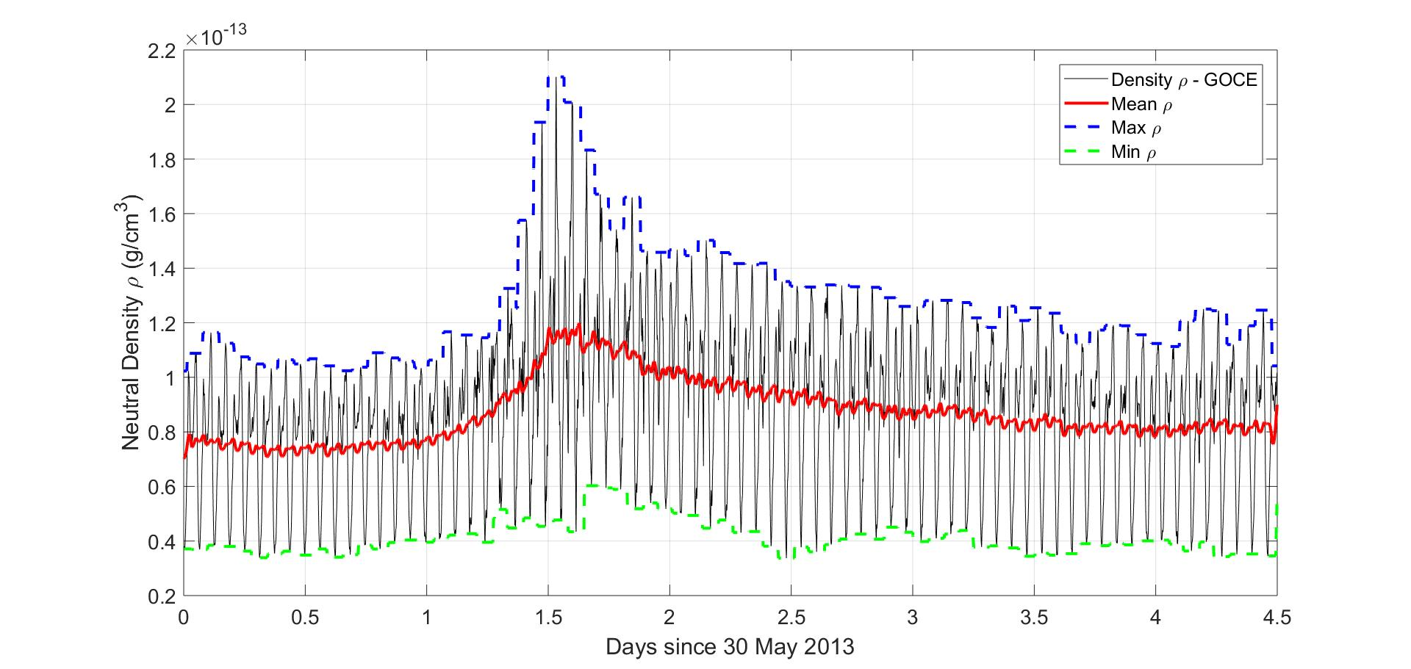
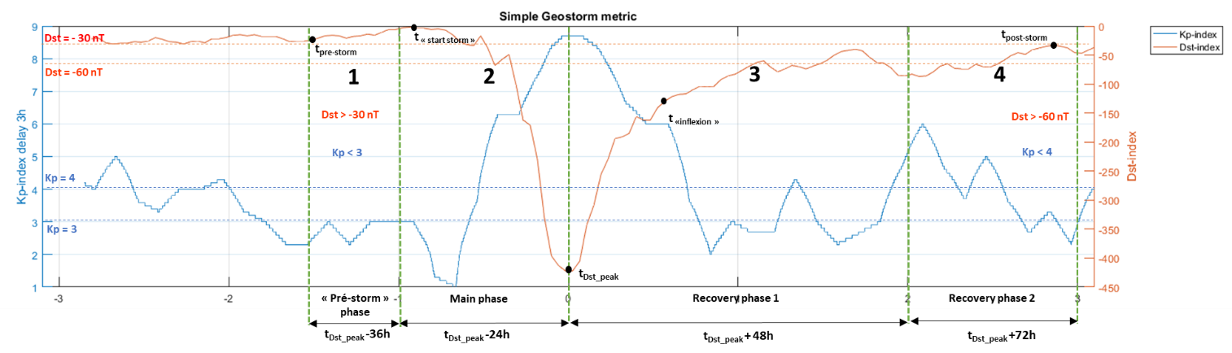
S. Bruinsma
Space Geodesy Office
13 / 20
Results DTM2019 - Storms
New storm-time metrics: (see ISWAT booth)
Storm in phases, statistics on storm & per phase
Orbit moving average and min/max values
Cumulative orbit-mean O/C

Slide 14
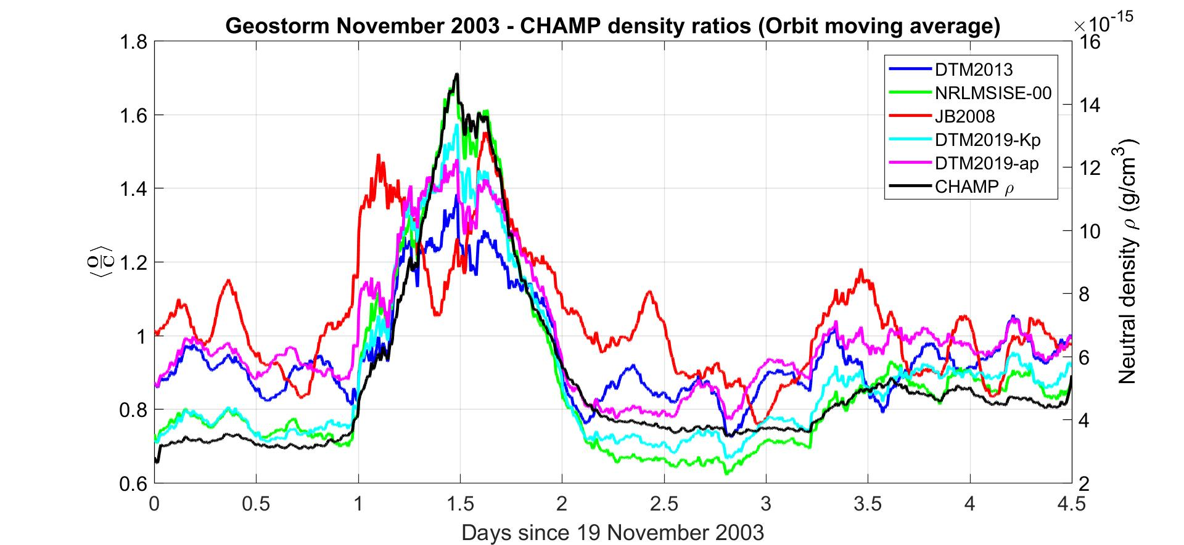
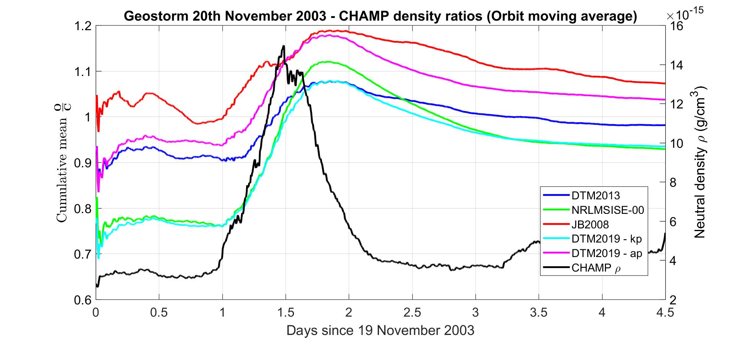
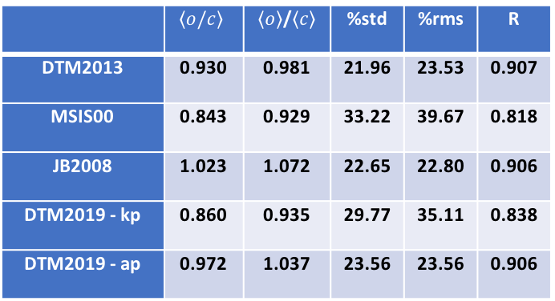
S. Bruinsma
Space Geodesy Office
14 / 20
Results DTM2019 - Storms
Example:
Statistics for CHAMP, November ’03,
for phases 1-4.
NB: density profile ‘old’ database
1
2
3
 | $$〈o/c〉$$ | $〈o〉$/$〈c〉$ | %std | %rms | R
DTM2013 | 0.930 | 0.981 | 21.96 | 23.53 | 0.907
MSIS00 | 0.843 | 0.929 | 33.22 | 39.67 | 0.818
JB2008 | 1.023 | 1.072 | 22.65 | 22.80 | 0.906
DTM2019 - kp | 0.860 | 0.935 | 29.77 | 35.11 | 0.838
DTM2019 - ap | 0.972 | 1.037 | 23.56 | 23.56 | 0.906

Slide 15
S. Bruinsma
Space Geodesy Office
15 / 20
Results DTM2019 - Storms
The effect of Hp on the modeling is small and hardly visible when presenting general statistics on O/C.
The model cannot reproduce the high amplitudes, which is due to spatial resolution

Slide 16
S. Bruinsma
Space Geodesy Office
16 / 20
Results DTM2019–longitude variations
Observation (GOCE) Model (DTM)
dusk
Low
Geomagnetic activity
DTM quite realistic
dawn

Slide 17
S. Bruinsma
Space Geodesy Office
17 / 20
Results DTM2019–longitude variations
Observation (GOCE) Model (DTM)
dusk
Low-medium
Geomagnetic activity
DTM getting worse
dawn

Slide 18
S. Bruinsma
Space Geodesy Office
18 / 20
Results DTM2019–longitude variations
Observation (GOCE) Model (DTM)
dusk
High
Geomagnetic activity
DTM cannot reproduce
dawn

Slide 19
S. Bruinsma
Space Geodesy Office
19 / 20
Summary and outlook
The DTM2019 models are still preliminary (delivery of final models as late as possible):
More data were assimilated, and CHAMP, SwarmA & GOCE were used without scaling,
An operational (F10.7, Kp) and a research (F30, Hp₆₀) grade model have been developed,
More precise than DTM2013, (and JB2008 and NRLMSISE-00)
They predict lower densities; this requires clear explanation for users.
Next:
The algorithm for high-cadence geomagnetic activity indices (Hp₆₀) must be refined,
Storm-time performance must be improved and will be assessed applying new metrics,
Weighting of datasets must be improved to remove remaining biases (SwarmA in ‘oper’), and increase precision (e.g. GRACE in ‘oper’),
Use ALL data: more Swarm & Stella, all Cryosat-2, new GRACE?, GRACE-FO?, GOLD?

Slide 20
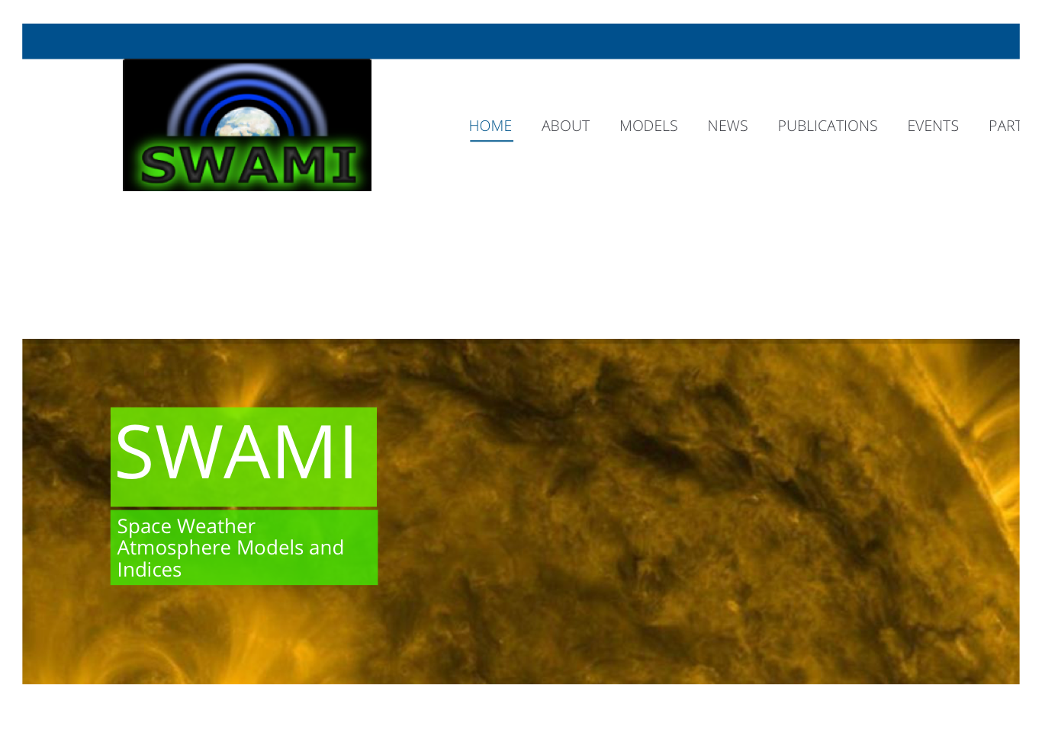
S. Bruinsma
Space Geodesy Office
20 / 20
H2020 SWAMI website
More information:
http://swami-h2020.eu

Slide 22
Metrics
Metrics to quantify model improvement are selected and benchmarks are established:
Mean, StD and R are computed on several time scales:
Annual
27-days
Daily
Orbit

Slide 23
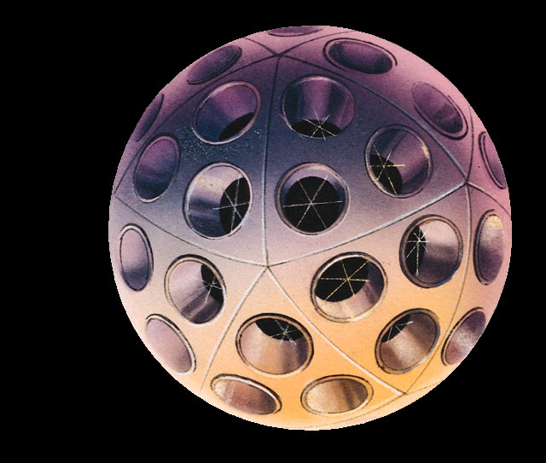
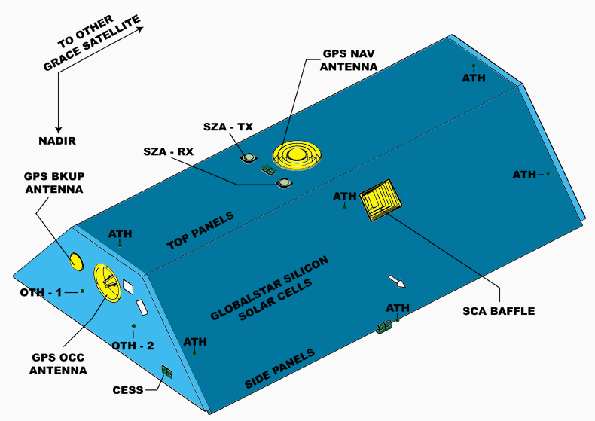
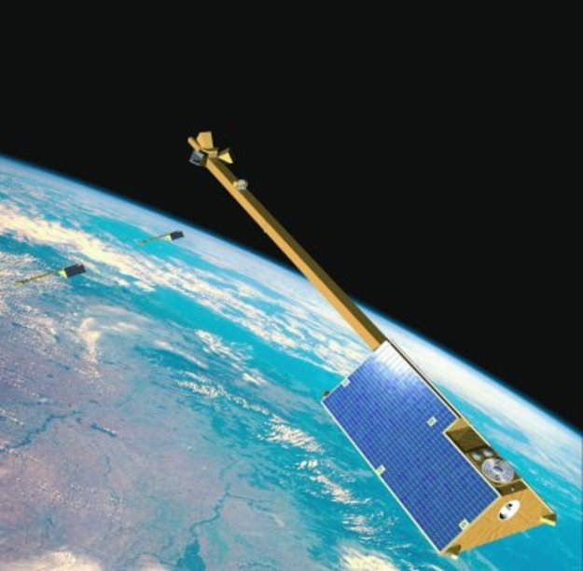
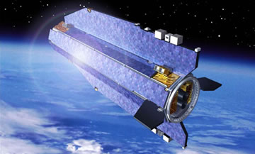
Total density data
S. Bruinsma
Space Geodesy Office
5/14
Data: CHAMP, GRACE and GOCE
Stella (POE)
CHAMP (2000-2010):
STAR resolution: 3·10⁻⁹ m/s²/Hz^{0.5}
GPS and SLR
inclination: 87°
Altitude: 460-300 km
GRACE (2002-2016):
SuperSTAR resolution: 1·10⁻¹⁰ m/s²/Hz^{0.5}
GPS and SLR
inclination: 90°
Altitude: 490-450 km
(1994-2016)
Swarm (‘GPS Acc’)
GOCE (2009 – 2013):
Acc. resolution: 1·10⁻¹² m/s²/Hz^{0.5}
ion propulsion
GPS and SLR
inclination: 96.5°
Altitude: 255-225 km
(7/2014 – 7/2017)

